Slide 1


BSc (Innovation and Technology)
2026-27 Intake

Slide 2
About I-School
Shaping Innovative Minds for the Global Future
Established in November 2024
Through project-led, problem-based learning:
  Integrates design thinking, entrepreneurship, and industry collaboration
Prepares students to tackle complex real-world challenges

Slide 3
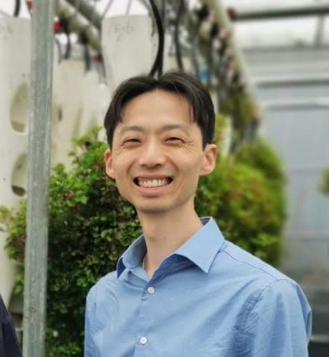
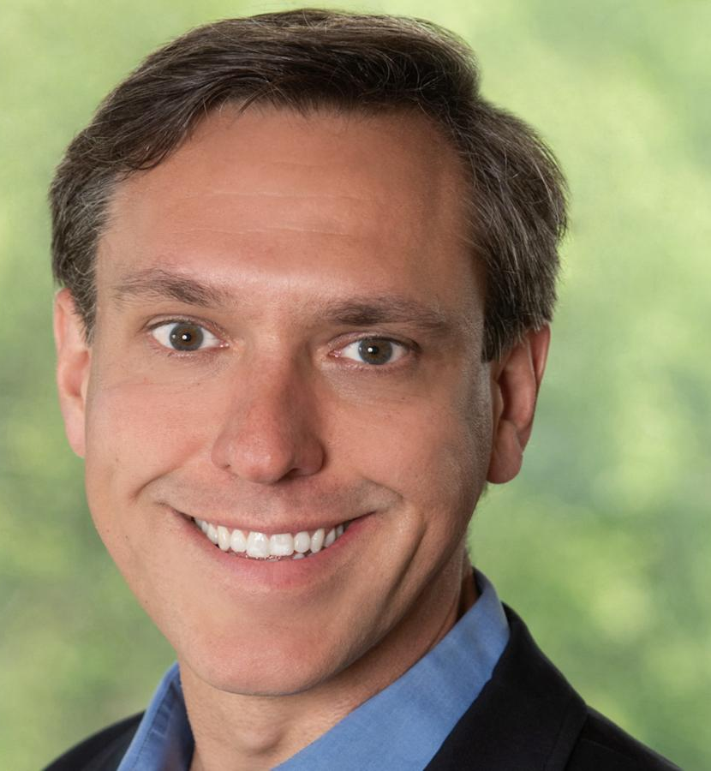
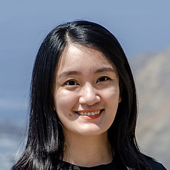
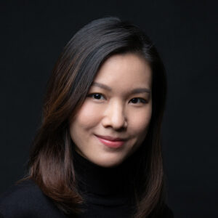
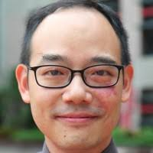
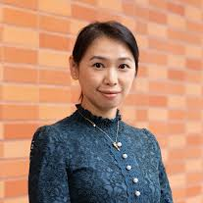
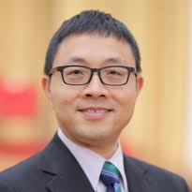
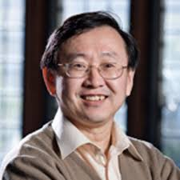
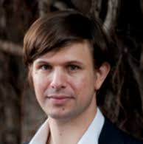
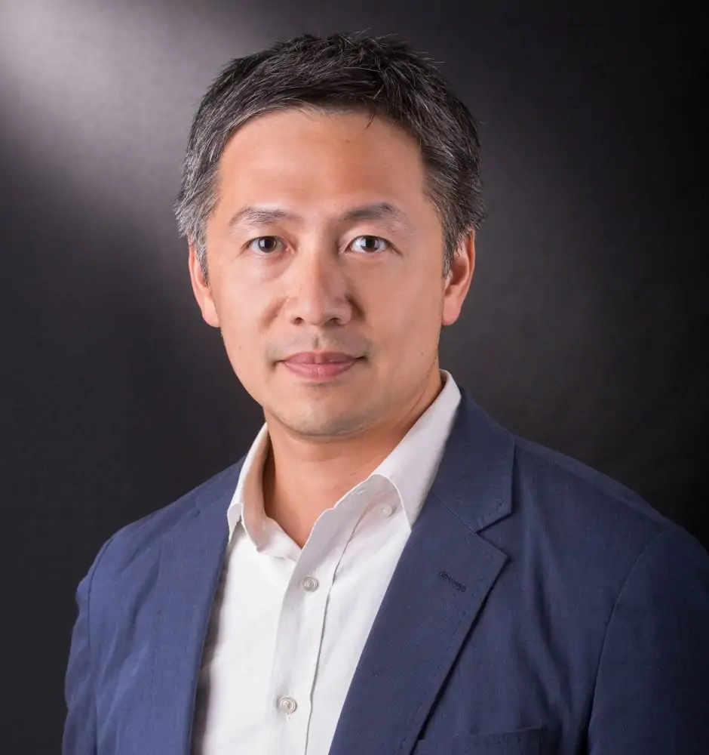
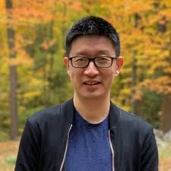
Teaching Team
Hayden SO
Director
School of Innovation
Jason WOODARD
Co-Director
School of Innovation
Fanny LI
School of Innovation
Connie LEE
School of Innovation
William CHEUNG
School of Innovation
Rachel LUI
Assistant Dean (e-Learning)
Faculty of Science
Edmund LAM
Electrical & Computer Engineering
Yiming RONG
Mechanical Engineering
Eric SCHULDENFREI
Former Head
Dept of Architecture
Joseph CHAN
Associate Director
Centre for Innovation
& Entrepreneurship
Nick FANG
Mechanical Engineering

Slide 4
About BSc(I&T)
Objective
  Designed to develop
    Technical capabilities
    Innovative mindset needed
  Turn ideas into impactful solutions for Hong Kong and beyond

Slide 5
Structure of BSc(I&T)
Programme Overview
A four-year interdisciplinary degree designed to train socially conscious innovators who combine science, engineering, and design to address real-world challenges with human-centred solutions.
Curriculum & Hands-on Learning
Foundation Courses: provide students with a solid foundation in skills and knowledge across science, mathematics, engineering, design, and business
Project Workshop Courses: Features a project-led, problem-based structure, allowing students to build practical problem-solving skills and gain confidence through cross-disciplinary collaboration.

Slide 6
Structure of BSc(I&T)
Tech Focus
Co-develops a course sequence with individual students through enhanced personalised academic advising to fulfil the requirements of acquiring a sufficient depth of knowledge and skills in technology discipline(s).
Co-op Experience
Includes full-time work at a startup, tech company, or research lab to apply problem-solving skills, lead solution projects, and incubate potential entrepreneurial ideas.
Final Year Capstone
Culminates in a comprehensive project where students form teams, propose their own ventures, and pitch their ideas.

Slide 7
Suggested Study Plan
Yr. | Sem. | Course | Title | Type | Credit
1 | 1 | INTC1001 | Human Centred Innovation | Project Workshop | 6
 | 1 | INTC1103 | Computational Problem Solving | Foundation | 6
 | 1 | INTC1201 | Modelling the World 1 | Foundation | 6
 | 1 | CCXXXX | Common Core Course | University Requirements | 6
 | 1 | CCXXXX | Common Core Course | University Requirements | 6
 | 1 | AILT1001 | Artificial Intelligence Literacy I | University Requirements | 3
 | 2+S# | INTC1002 | Physical Computing | Project Workshop | 12
 | 2 | INTC1204 | Sensing the World | Foundation | 6
 | 2 | INTC1202 | Modelling the World 2 | Foundation | 6
 | 2 | INTC1421 | Sciences & Technologies through Time | Foundation | 6
 | 2 | AILT9020 | Artificial Intelligence as an Innovation Co-creator | University Requirements | 3
2 | 1 | INTC2001 | Innovations for the Future (Co-requisite: CAES9521) | Project Workshop | 6
 | 1 | CAES9521 | English for Innovation and Technology (Co-requisite: INTC2001) | University Requirements | 6
 | 1 | INTC2401 | Innovation and Entrepreneurship | Foundation | 6
 | 1 | CCXXXX | Common Core Course | University Requirements | 6
 | 1 | AILT9020 | Tech Focus | Free Elective | 6
 | 2+S | INTC2002 | Making Sciences | Project Workshop | 12
 | 2 | INTC2301 | Forms and Materials | Foundation | 6
 | 2 | CENG9001 | Practical Chinese for Engineering Students | University Requirements | 6
 | 2 | CCXXXX | Common Core Course | University Requirements | 6
 | 2 |  | Tech Focus | Free Elective | 6
3 | 1 | INTC3001 | Innovations for Social Impact | Project Workshop | 6
 | 1 | CCXXXX | Common Core Course | University Requirements | 6
 | 1 | CCXXXX | Common Core Course | University Requirements | 6
 | 1 |  | Tech Focus | Free Elective | 6
 | 1 |  | Tech Focus | Free Elective | 6
 | 2+S | INTC3002 | Co-op Experience in Innovation Project | Co-op | 18
4 | 1+2 | INTC4001 | Capstone Project | Project Workshop | 12
 | 1 |  | Tech Focus | Free Elective | 6
 | 1 |  | Tech Focus | Free Elective | 6
 | 1 |  | Free Elective | Free Elective | 6
 | 1 |  | Free Elective | Free Elective | 6
 | 2 |  | Free Elective | Free Elective | 6
 | 2 |  | Free Elective | Free Elective | 6
 | 2 |  | Free Elective | Free Elective | 6
 | 2 |  | Free Elective | Free Elective | 6
Provided to students for reference when course selection
Full details will be sent via email shortly

Slide 8
Academic Advising Support
Academic Advisers for Year 1 Students:
Dr. William CHEUNG
  Email: willmyc@hku.hk
Prof. Rachel LUI
  Email: lui2012@hku.hk

Slide 9

About I-School
For enquiries, please contact us at ug.ischool@hku.hk
Follow IG:
I-School Website:
i-school.hku.hk

